Slide 1
DESIGN AND ANALYSIS OF ALGORITHMS
UNIT I
INTRODUCTION TO ALGORITHM
ALGOORITHM SPECIFICATION
PERFORMANCE ANALYSIS
RANDOMIZED ALGORITHMS
DIVIDE AND CONQUER
GENERAL METHOD
APPLICATIONS-BINARY SEARCH, MERGE SORT, QUICK SORT, STRASSEN’S MATRIX MULTIPLICATION.

Slide 2
1. INTRODUCTION TO ALGORITHM
Algorithm is defined as finite sequence, of Instructions/steps to solve a problem.
Example: Matrix Multiplication Problem
Example: Student Progress Report
Analysis
It is a process of comparing two algorithms with respect to time and space.

Slide 3
1. INTRODUCTION TO ALGORITHM
Analysis is of two types
Posterior
Prior
Posterior Analysis: It is the analysis that is performed after execution.( Machine Dependent).
Prior Analysis: It is the analysis that is performed before execution. ( Machine independent).

Slide 4
2. Algorithm specification
In analyzing an algorithm, rather than a piece of code, we will try and predict the number of times "the principle activity" of that algorithm is performed. For example,
if we are analyzing a sorting algorithm we might count the number of comparisons performed, and if it is an algorithm to find some optimal solution, the number of times it evaluates a solution.
If it is a graph coloring algorithm we might count the number of times we check that a colored node is compatible with its neighbors.

Slide 5
2. Algorithm specification
computer used, the hardware platform
representation of abstract data types (ADT's)
efficiency of compiler
competence of implementer (programming skills)
complexity of underlying algorithm
size of the input

Slide 6
3. Performance analysis
The performance analysis is observed with respect to two types:
Time complexity
Space complexity

Slide 7
3. Performance analysis-Time complexity
What is Time Complexity
“time complexity is the amount of time taken by an algorithm to run, as a function of the length of the input”.
Time complexity measures the time taken to execute each statement of code in an algorithm. If a statement is set to execute repeatedly then the number of times that statement gets executed is equal to N multiplied by the time required to run that function each time.

Slide 8
3. Performance analysis-Time complexity
Time complexity is given by time as a function of length of input. And, there exists a relation between the input data size (n) and number of operations performed (N) with respect to time.
This relation is denoted as Order of growth in Time complexity and given notation O[n] where O is the order of growth and n is the length of input. It is also called as ‘Big O Notation’

Slide 9
Example
For (i=n;i>0;i--)
{
Start ; // the value decrements from n to 0 i.e., n times the loop is executed therefore the value is n//
}
for(i=0;i<n;i++)
{
Start ; // the value increments from 0 to n i.e., n times the loop is executed therefore the value is n//
}
For (i=1;i<n;i=i+2)
{
Start; // the value of n is incremented by 2; i.e., n/2
}

Slide 10
For (i=0;i<n;i++)
{ //time taken for execution is n+1 units //
For(j=0;j<n; j++)
{//time taken for execution is n(n+1) units
Start
}
}

Slide 11
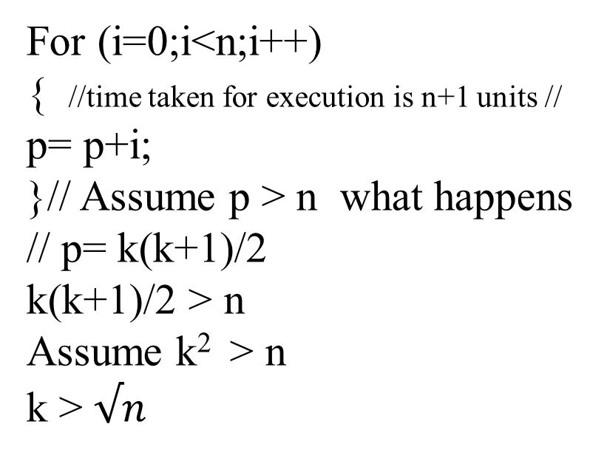
For (i=0;i<n;i++)
{ //time taken for execution is n+1 units //
For(j=0;j<n; j++)
{//time taken for execution is n(n+1) units
Start
}
}
For (i=0;i<n;i++)
{ //time taken for execution is n+1 units //
p= p+i;
}// Assume p > n what happens
// p= k(k+1)/2
k(k+1)/2 > n
Assume k² > n
k > $√n$

Slide 12
Example // Assume i > = n
For (i=0;i<n;i=i*2) i=2^{k}
{ 2^{k} > = n
Start 2^{k} = n
} k = log₂n
}
Similar even
For( i=n;i=1;i=i/2)

Slide 13
Analysis of While condition
While (condition) do repeat
{ { {
Start start start
} }while (condition) }until (condition)
Example:
a=1;
While(a < b) Assume a >= b
{ 2^{k} >= b
a=a *2; 2^{k} = b
} k = log₂b

Slide 14
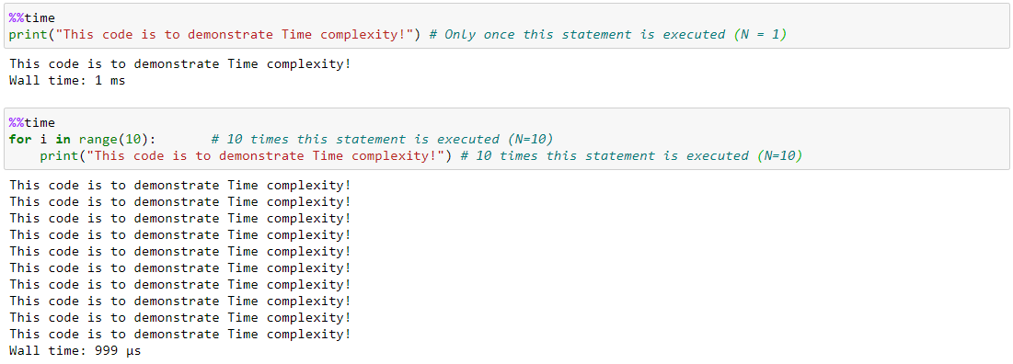
3. Performance analysis-Time complexity
For Example from the code below

Slide 15
3. Performance analysis-Time complexity
First algorithm is defined to print the statement only once. The time taken to execute is shown as 1 millisecond.
While the second algorithm is defined to print the same statement but this time it is set to run the same statement in FOR loop for 10 times.
In the second algorithm, the time taken to execute both the line of code – FOR loop and print statement, is 2 millisecond. And, the time taken increases, as N value increases, since the statement is going to get executed N times.

Slide 16
3. Performance analysis-Time complexity
There are different types of time complexities used, let’s see one by one:
1. Constant time – O (1)
2. Linear time – O (n)
3. Logarithmic time – O (log n)
4. Quadratic time – O (n^2)
5. Cubic time – O (n^3)

Slide 17
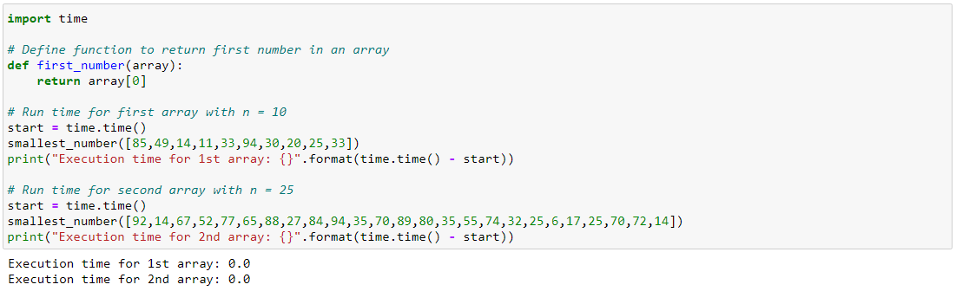
3. Performance analysis-Time complexity
An algorithm is said to have constant time with order O (1) when it is not dependent on the input size n. Irrespective of the input size n, the runtime will always be the same.

Slide 18
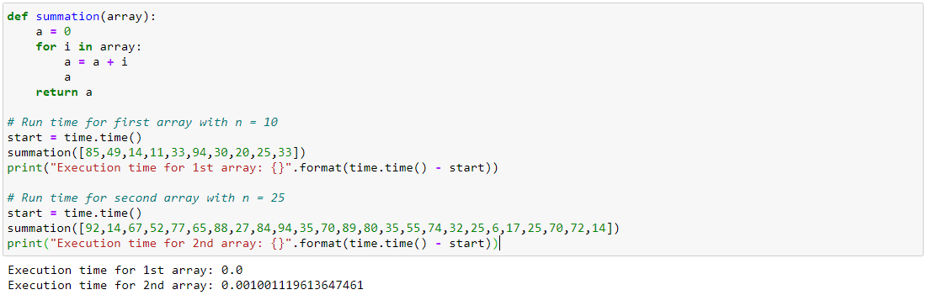
3. Performance analysis-Time complexity
An algorithm is said to have a linear time complexity, where the running time increases linearly with the length of the input. When the function involves checking all the values in an input data, such function has Time complexity with this order O(n).

Slide 19
3. Performance analysis-Time complexity
An algorithm is said to have a logarithmic time complexity when it reduces the size of the input data in each step. This indicates that the number of operations is not the same as the input size. The number of operations gets reduced as the input size increases. Algorithms with Logarithmic time complexity are found in binary trees or binary search functions. This involves the search of a given value in an array by splitting the array into two and starting searching in one split. This ensures the operation is not done on every element of the data.

Slide 20
3. Performance analysis-Time complexity
Quadratic time – O (n^2)
An algorithm is said to have a non – linear time complexity where the running time increases non-linearly (n^2) with the length of the input. Generally, nested loops come under this time complexity order where for one loop takes O(n) and if the function involves loop within a loop, then it goes for O(n)*O(n) = O(n^2) order.
Similarly, if there are ‘m’ loops defined in the function, then the order is given by O (n ^ m), which are called as polynomial time complexity functions.

Slide 21
3. Performance analysis-Time complexity
Let us illustrate on how to evaluate the time complexity of an algorithm with an example:
The algorithm is defined as:
1. Given 2 input matrices A,B , which are square matrix with order n
2. The values of each element in both the matrices are selected randomly using np.random function
3. Initially assigned a result matrix with 0 values of order equal to order of input matrix
4. Each element of X is multiplied with every element of Y and the resultant value is stored in result matrix
5. The result matrix is then converted to list type
6. For every element in the result list, is added together to give final answer

Slide 22
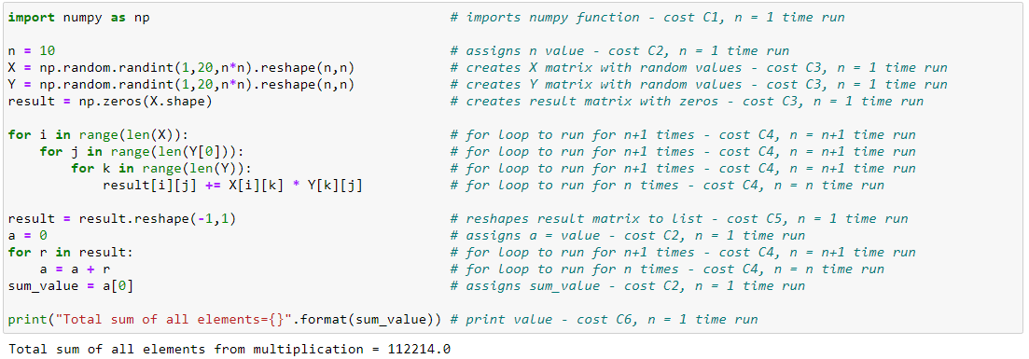
3. Performance analysis-Time complexity

Slide 23
3. Performance analysis-space complexity
The space complexity of an algorithm or a computer program is the amount of memory space required to solve an instance of the computational problem as a function of characteristics of the input.
It is the memory required by an algorithm until it executes completely.

Slide 24
3. Performance analysis-space complexity
O(1) – constant complexity – takes the same amount of space regardless of the input size
O(log n) – logarithmic complexity – takes space proportional to the log of the input size
O(n) – linear complexity – takes space directly proportional to the input size
O(n log n) – log-linear/quasilinear complexity – also called “linearithmic”, its space complexity grows proportionally to the input size and a logarithmic factor
O(n^2) – square/polynomial complexity – space complexity grows proportionally to the square of the input size

Slide 25
3. Performance analysis-space complexity
Omega Notation – Ω
Omega notation expresses an asymptotic lower bound.
It gives the best-case scenario of an algorithm’s complexity,
opposite to big-O notation.
Theta Notation – θ
Theta notation represents a function that is within lower and upper bounds.
We can say that: “the algorithm’s space takes at least that (lower bound function) amount of space and no more than that (maximum bound function) amount of space”.

Slide 26
3. Performance analysis-space complexity
Analyzing Space Complexity of Algorithms
The ability to calculate space complexity is essential in considering an algorithm’s efficiency.
Above all, it’s necessary to mention that space complexity depends on a variety of things such as the programming language, the compiler, or even the machine running the algorithm.

Slide 27
3. Performance analysis-space complexity
let’s consider a simple Java operation that sums two integers (numbers without a fractional part):
public int sum(int a, int b) { return a + b; }
In this particular method, three variables are used and allocated in memory:
the first int argument, a
the second int argument, b
and the returned sum result which is also an int like a and b
In Java, a single integer variable occupies four bytes of memory. In this example, we have three integer variables. Therefore, this algorithm always takes 12 bytes of memory to complete (3*4 bytes).
We can clearly see that the space complexity is constant, so, it can be expressed in big-O notation as O(1).

Slide 28
3. Performance analysis-space complexity
Determine the space complexity of a program that sums all integer elements in an array:
public int sumArray(int[] array) { int size = array.length; int sum = 0; for (int iterator = 0; iterator < size; iterator++) { sum += array[iterator]; } return sum; }
list all variables present in the above code:
array – the function’s only argument – the space taken by the array is equal 4n bytes where n is the length of the array
size – a 4-byte integer
sum – a 4-byte integer
iterator – a 4-byte integer
The total space needed for this algorithm to complete is 4n + 4 + 4 + 4 (bytes). The highest order of n in this equation is just n. Thus, the space complexity of that operation is O(n).

Slide 29
3. Performance analysis
A function of input. However, we will attempt to characterize this by the size of the input. We will try and estimate the WORST CASE, and sometimes the BEST CASE, and very rarely the AVERAGE CASE. This phenomenon is referred as asymptotic notation.
WORST CASE: is the maximum run time, over all inputs of size n, ignoring effects (a) through (d) above. That is, we only consider the "number of times the principle activity of that algorithm is performed".

Slide 30
3. Performance analysis
Best Case: In this case we look at specific instances of input of size n. For example, we might get best behavior from a sorting algorithm if the input to it is already sorted.
Average Case: Arguably, average case is the most useful measure. It might be the case that worst case behavior is pathological and extremely rare, and that we are more concerned about how the algorithm runs in the general case.
It is typically very difficult thing to measure. Firstly, we must in some way be able to define by what we mean as the "average input of size n". We would need to know a great deal about the distribution of cases throughout all data sets of size n.
Alternatively we might make a possibly dangerous assumption that all data sets of size n are equal likely.

Slide 31
4. Randomized Algorithms
Why Randomness ?
Randomness can guarantee (probabilistically) average case behavior.
Efficient approximate solutions for intractable problems.
Avoid Worst case Behavior.
What is Randomized Algorithm?
The input function of an algorithm is dependent on random numbers, these random numbers shall support for finding a solution or improving a solution for a given problem.

Slide 32
4. Randomized Algorithms
Randomized algorithms(probabilistic algorithms)
There are 2 types of randomized algorithms
For an optimization problem the randomized algorithm gives an optimal solution. The average time complexity is more important than worst case time complexity.
For a decision problem the randomized algorithm may make mistakes. The probability of producing wrong results is small.

Slide 33
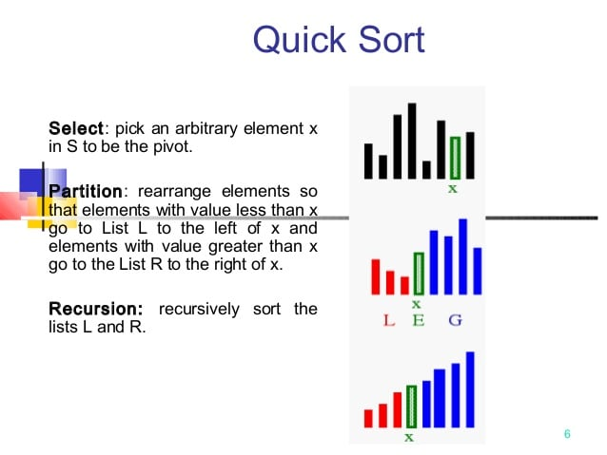
4. Randomized Algorithms

Slide 34
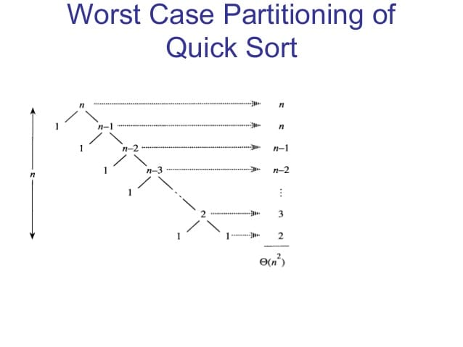
4. Randomized Algorithms

Slide 35
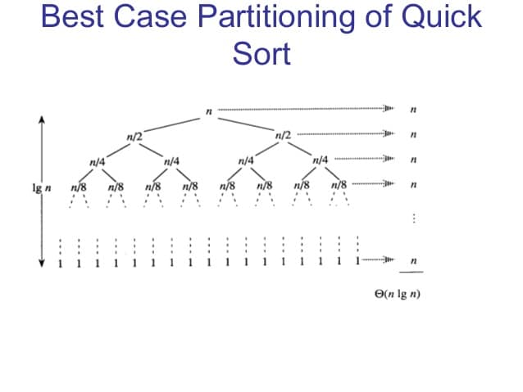
4. Randomized Algorithms

Slide 36
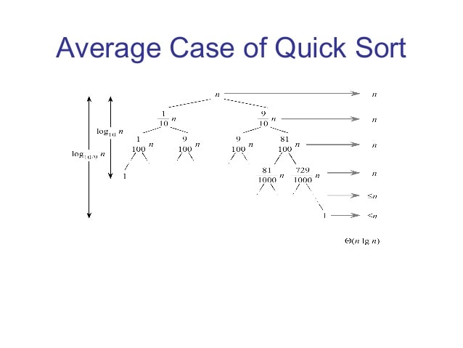
4. Randomized Algorithms

Slide 37
4. Randomized Algorithms
Randomized-partition (A, p, r)
i = random ( p, r)
Exchange A[r] = A[i]
Return partition (A, p, r)
Randomized-quicksort (A, p, r)
If p< r,
Then q= Randomized-partition (A, p, r)
Randomized-quicksort(A, p, q-1)
Randomized-quicksort(A, q+1, r)

Slide 38
4. Randomized Algorithms
Exchange A[r] with an element chosen at random from A[p-r] in Partition.
The pivot element is equally likely to be any of the input elements.
For a given input, the behavior of Randomized quicksort is determined not only by the input, but also by the random choices of the pivot.
Randomization is implied to quicksort such that for any input the expected performance of the algorithm is good.

Slide 39
5. DIVIDE AND CONQUER
It is a algorithm design paradigm
The major phenomenon is it divides the problem into two or more sub-problems of the same or related type.
The correctness of the divide and conquer approach is proved by mathematical induction.
The computational cost is often determined by solving recurrence relations.
Divide-and-conquer approach to sort the list (38, 27, 43, 3, 9, 82, 10) in increasing order. Upper half: splitting into sub lists; mid: a one-element list is trivially sorted; lower half: composing sorted sub lists.

Slide 40
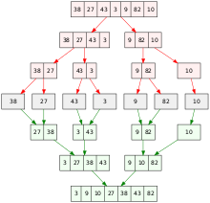
5. DIVIDE AND CONQUER

Slide 41
5. DIVIDE AND CONQUER
Algorithm DAndC(p)
{
if Small(p) then return s(p);
else
{
divide p into smaller instances P₁, P_{2,} P_{3,} ….. , P_{k} , k≥1;
Apply DAndC to each of these subproblems;
return Combine(DAndC(P₁), DAndC(P₂),…, DAndC(P_{k}));
}
}

Slide 42
5. DIVIDE AND CONQUER
If the size of p is n and the sizes of the k sub problems are n₁,n₂,….,n_{k}, then the computing time of DAndC is described by the recurrence relation
g(n) n small
T(n)= T(n₁)+T(n₂)+……+T(n_{k})+f(n) Otherwise
Where T(n) is the time for DAndC on any input of size n and g(n) is the time to compute the answer directly for small inputs.
The function f(n) is the time for dividing p and combining the solutions to sub problems.

Slide 43
5. DIVIDE AND CONQUER
The Time Complexity of many divide-and-conquer algorithms is given by recurrences of the form
c n small
T(n)=
a T(n/b) + f(n) Otherwise
Where a ,b and c are known constants
and
n is a power of (i.e. n = b^{k} )

Slide 44
5. DIVIDE AND CONQUER
Advantages of divide and conquer
Solving difficult problems
Algorithm efficiency: in may examples that are used to study the Divide and conquer approach led to the improvement of asymptotic cost of the solution. Like for example if, the base cases have constant-bound size, the work of splitting the problem and combining the partial solutions is proportional to problem size n and there is a bounded number p of sub-problems of size n/p at each stage, then the cost of the divide and conquer algorithm will be
O(n log_{p} n)

Slide 45
5. DIVIDE AND CONQUER
3. Parallelism: Divide and conquer algorithms are naturally adapted for execution in multi-processor machines, especially share-memory systems where the communication of data between processors does not need to be planned in advance, because the distinct problems can be executed on different processors.
4. Memory access: use of cache memory for computing the sub problems within itself.

Slide 46
Applications-binary search
Algorithm for Binary search
1. Initial consider the values of an sorted array of size n.
2. Assign the first value of array to low=l; last value of array to high=h and the middle value of sorted array to mid=m and the element to be searched as x
2. Compare x with the mid.
3. If x matches with the mid, we return the mid as index.
4. Else If x is greater than the mid element, then x can only lie in the right half subarray after the mid. So we recur for the right half.
5. Else (x is smaller) recur for the left half.

Slide 47
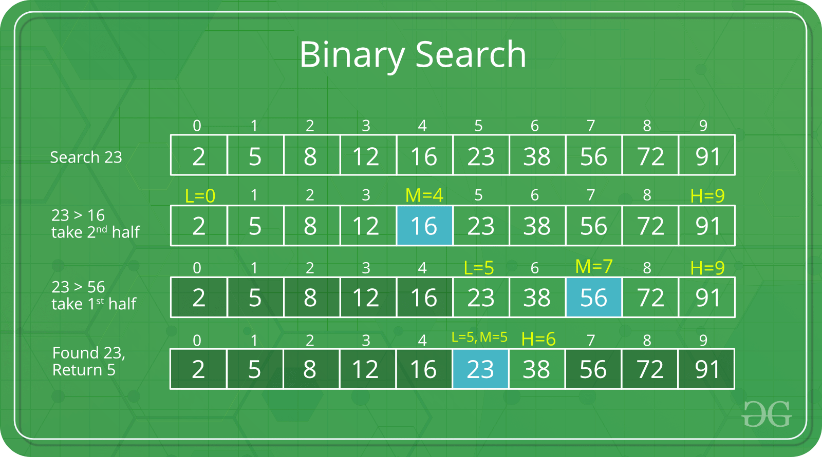
Applications-binary search

Slide 48
Binary search algorithm ( Using Divde and conquer approach)
Algorithm RBinSearch(l,h,k,a)
{
if(l=h)
{
if(a[l]=k) then return i;
else return “not found”;
}
else
{
mid := floor [(l+h)/2] 1
if(a[mid] = k) then return mid; 1
else if(a[mid] > k) then
return RBinSearch(l,mid-1,k,a);
else T(n/2)
return RBinSearch(mid+1,h,k,a);
}
}
Back Substitution Method
1 if n = 1
T(n) =
T(n/2) + 1 if n > 1
T(n) = T(n/2) + 1 ---- ①
Substitute n = n/2 in T(n) i.e., eq①
------ ②
Substitute eq ② in eq ①
∴ T(n) = (T(n/2²) + 1) + 1
T(n) = T(n/2²) + 2 --------------③
.
.
T(n) = T(n/2^{k}) + k
Assume n/2^{k} = 1
∴ n = 2^{k}
log n = log 2^{k}
log n = k log₂ 2
∴ k = log n
T(n) = T(1) + log n
∴ T(n) = 1+ log n = O(log n)
T(n/2) = T(n/2²) + 1
Recurrence relation:
1 if n = 1
T(n) =
T(n/2) + 1 if n > 1

Slide 49
APPLICATIONS-MERGE SORT
In Merge Sort application the Divide and Conquer Design paradigm is implemented.
It divides the input array into two halves, calls itself for the two halves, and then merges the two sorted halves.
The Algorithm designed for implementing merge sort involves two functions.
1. merge function – used for merging two halves
2. mergesort() function- a recursive function calls itself to divide
the array till size becomes one.

Slide 50
APPLICATIONS-MERGE SORT
The merge(arr, l, m, r) is a key process that assumes that arr[l..m] and arr[m+1..r] are sorted and merges the two sorted sub-arrays into one.
Algorithm Mergesort(arr[], l, r)
If r > 1
1. find the middle point to divide the array into two halves;
middle m = l + (r-1)/2
2. call mergesort for first half ; call merge sort (arr, l, m);
3. call mergesort for second half; call mergesort (arr, m+1, r)
4. Merge the two halves sorted in step 2 and step 3;
call merge(arr, l, m, r)

Slide 51
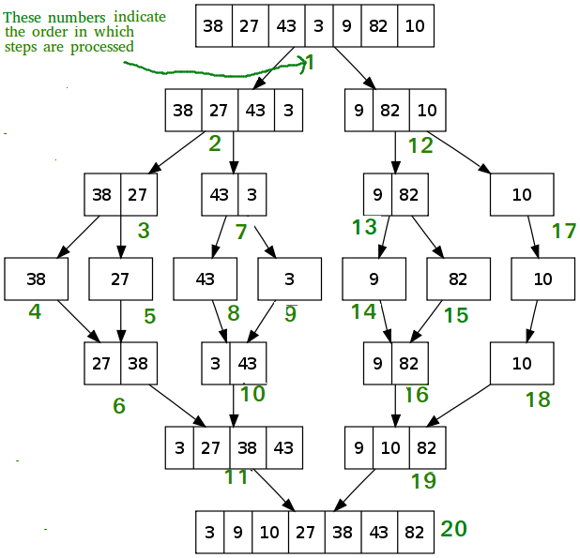
APPLICATIONS-MERGE SORT

Slide 52
APPLICATIONS-MERGE SORT
If r > 1
find the middle point to divide the array into two halves;
middle m = l + (r-1)/2 -------→ 1 unit
2. call mergesort for first half ; call merge sort (arr, l, m); --T(n/2)
3. call mergesort for second half; call mergesort (arr, m+1, r)– T(n/2)
4. Merge the two halves sorted in step 2 and step 3;
call merge(arr, l, m, r) ------ n
Recurrence Relation
T(n) = 1 if n=1
2T(n/2) + n if n>1
T(n) = Ɵ(nlogn)

Slide 53
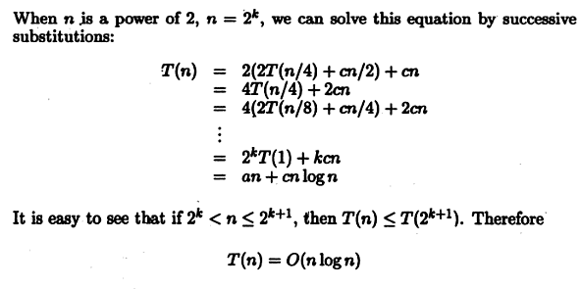
DAA - Unit – I Part 3 Presentation Slides
53

Slide 54
APPLICATIONS-STRASSEN’S MULTIPLICATION
The naïve of algorithm is often better for smaller matrices.
It is faster than the standard matrix multiplication algorithm for large matrices, with a better asymptotic complexity.
It is proved that this method has optimal solutions for a width of 32 to 128 sizes.
This method is also known as Combinatorial Matrix Multiplication.

Slide 55
APPLICATIONS-STRASSEN’S MULTIPLICATION
Basic Matrix Multiplication
Let A an B two n×n matrices. The product C=AB is also an n×n matrix.
Time complexity of above
algorithm is
T(n)=O(n³)
Algorithm matrix_mult ()
{
for (i = 1; i <= N; i++) {
for (j = 1; j <= N; j++) {
for(k=1; k<=N; k++){
C[i,j]=C[i,j]+A[i,k]+B[k,j]; }
}
}
}

Slide 56

APPLICATIONS-STRASSEN’S MULTIPLICATION
We want to compute the product C=AB, where each of A,B, and C are n×n matrices.
Assume n is a power of 2.
If n is not a power of 2, add enough rows and columns of zeros.
We divide each of A,B, and C into four n/2×n/2 matrices, rewriting the equation C=AB as follows:

Slide 57
APPLICATIONS-STRASSEN’S MULTIPLICATION
Then,
C₁₁=A₁₁B₁₁+A₁₂B₂₁
C₁₂=A₁₁B₁₂+A₁₂B₂₂
C₂₁=A₂₁B₁₁+A₂₂B₂₁
C₂₂=A₂₁B₁₂+A₂₂B₂₂
Each of these four equations specifies two multiplications of n/2×n/2 matrices and the addition of their n/2×n/2 products.
We can derive the following recurrence relation for the time T(n) to multiply two n×n matrices:
T(n)= c₁ if n <= 2
8T(n/2)+ c₂n² if n > 2
A₁₁
A₁₂
B₁₁
B₁₂
A₂₁
A₂₂
B₂₁
T(n) = O(n³)

Slide 58
APPLICATIONS-STRASSEN’S MULTIPLICATION
T(n) = 8T(n/2)+ c₂n²
=8 8T(n/4)+ c₂(n/2)² ⁺ c₂n²
= 8² T(n/4)+ c₂2n² ⁺ c₂n²
=8² 8T(n/8)+ c₂(n/4)² + c₂2n² + c₂n²
=8³ T(n/8)+ c₂4n² + c₂2n² + c₂n²
:
=8^{k}T(1)+ ………………+ c₂4n² + c₂2n² + c₂n²
⁼ 8^{log}₂^{n} c₁ + c n²
=n^{log}2 c₁ + c n² = n³ c₁+ cn² ⁼ O(n³ )

Slide 59
APPLICATIONS-STRASSEN’S MULTIPLICATION
Matrix multiplications are more expensive than matrix additions or subtractions( O(n³) versus O(n²)).
Strassen has discovered a way to compute the multiplication using only 7 multiplications and 18 additions or subtractions.
His method involves computing 7 n×n matrices M₁,M₂,M₃,M₄,M₅,M₆, and M_{7,} then cij’^{s} are calculated using these matrices.

Slide 60
APPLICATIONS-STRASSEN’S MULTIPLICATION
Formula for Strassen multiplication
M₁ = (A₁₁ + A₂₂) ∗ (B₁₁ + B₂₂)
M₂ = (A₂₁ + A₂₂) ∗ B₁₁
M₃ = A₁₁ ∗ (B₁₂ – B₂₂)
M₄ = A₂₂ ∗ (B₂₁ – B₁₁)
M₅ = (A₁₁ + A₁₂) ∗ B₂₂
M₆ = (A₂₁ – A₁₁) ∗ (B₁₁ + B₁₂)
M₇ = (A₁₂ – A₂₂) ∗ (B₂₁ + B₂₂)
C₁₁=M1 + M4 - M₅ + M₇
C₁₂= M₃ + M₅
C₂₁= M₂ + M₄
C₂₂=M₁ + M₃ - M₂ + M₆

Slide 61
APPLICATIONS-STRASSEN’S MULTIPLICATION
C₁₁ C₁₂ A₁₁ A₁₂ B₁₁ B₁₂
= *
C₂₁ C₂₂ A₂₁ A₂₂ B₂₁ B₂₂
M₁ + M₄ - M₅ + M₇ M₃ + M₅
=
M₂ + M₄ M₁ + M₃ - M₂ + M₆
The resulting recurrence relation for T(n) is
T(n)= c₁ n<=2
7T(n/2) +c₂n² n>2

Slide 62

APPLICATIONS-STRASSEN’S MULTIPLICATION
T(n)= 7^{k}T(1) + c₂n² 1+ 7/4 + (7/4)² + (7/4) ³+……………..+ (7/4)^{k-1}
⁼ 7^{log}₂^{n} c₁ +c₂ n² (7/4)^{log}₂^{n}
⁼ n^{log}₂⁷ + n^{log}₂⁴ ( n ^{log}₂^{7-log}₂⁴ )
=2 n^{log}₂⁷ = O(n^{log}₂⁷) ~ O( n^{2.81})

